Slide 1
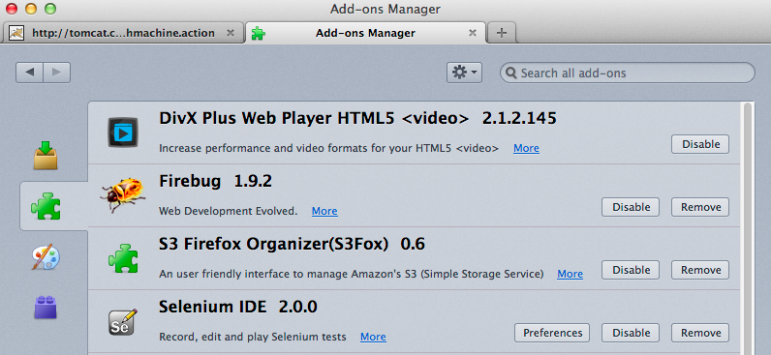
Hands – On : Selenium IDE
Pre-requisites: Firefox
Install Selenium IDE add-on (http://seleniumhq.org/projects/ide)

Slide 2
Hands – On : Selenium IDE
Story #1 : Cash Withdrawal
As a Customer
I want to withdraw $100
So that I can buy a present for my mum
https://github.com/jdamore/tw-selenium-training/blob/master/ide/CashmanWithdrawal

Slide 3
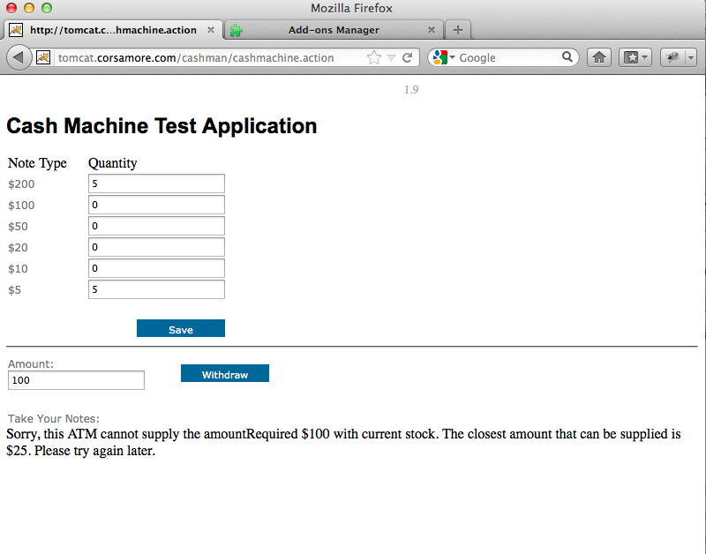
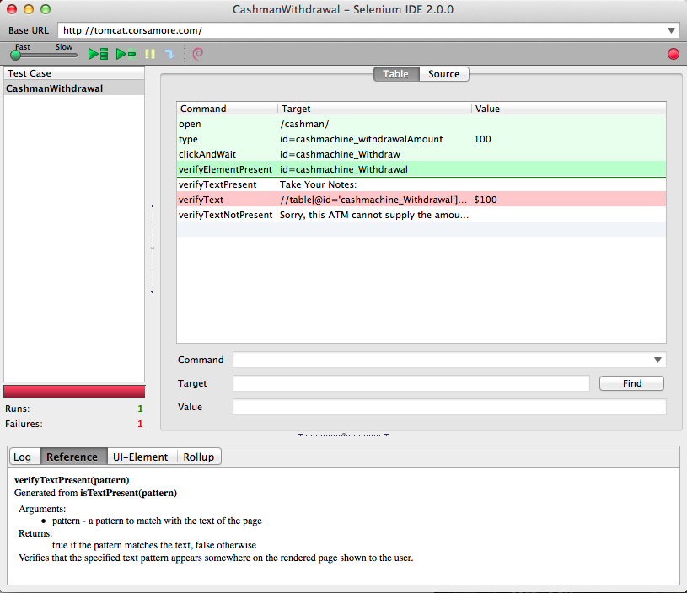
Hands – On : Selenium IDE

Slide 4
Hands – On : Selenium IDE
Story #2 : Stock Management
As a Manager
I want to add $100 notes
So that customers can withdraw large amounts
https://github.com/jdamore/tw-selenium-training/blob/master/ide/CashmanStockManagement

